Slide 1
Reparametrizing Distributions on Lie Groups
Luca Falorsi, Pim de Haan, Tim R. Davidson, Patrick Forré

Slide 2
Probabilistic Approach
Given observation X, Assume: Latent Structure Z
Want to infer the posterior over latent variables given observations, p(Z|X)
Baye’s Rule: intractable in practice
Variational Inference
Reparameterization trick
Z
X
Notes:
Deep learning: powerful way to learn arbitrary functions
transforms inference task into an optimization problem
find distribution q(Z), that best approximates true posterior
Reparameterization trick crucial to enable VI in DL

Slide 3
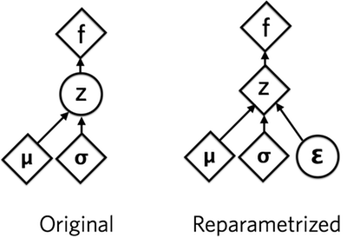
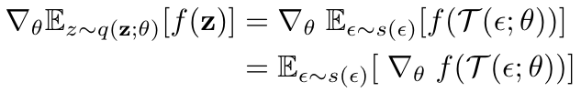
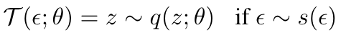
Reparameterization trick
Notes:
We want to:
Take unbiased, low variance gradients with respect to the distribution’s parameters
We need to be able to:
Take samples of the distribution by first sampling a simple distribution independent on the parameters and then transforming it into the target distribution
Compute the density (often useful for computing KL using MC estimates)

Slide 4
Reparameterization trick
No general trick for arbitrary density
Extending reparameterizable densities
Normalizing Flows (Rezender & Mohammed 2014)
Acceptance Rejection Sampling (Naesseth et al. 2017)
Implicit Reparameterization (Figurnov et al. 2018)
Assumes Euclidean space

Slide 5

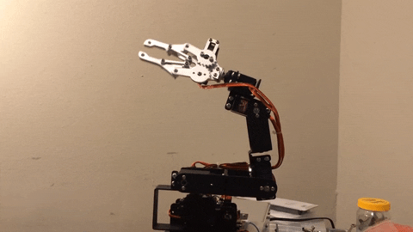
What about other spaces?
Lie groups: influential class of spaces with non-trivial topologies
Can we create reparametrizable distributions on Lie groups?
Notes:
fundamental building block in many subbranches of Physics (Standard Model), Mathematics (Langdon Program), Control Theory
Example 1: estimate position and orientation of a Drone
Example 3: maximum entropy reinforcement learning on a Robotic Arm

Slide 6
What about other spaces?
Lie groups: influential class of spaces with non-trivial topologies
Can we create reparametrizable distributions on Lie groups?
This paper
Create reparametrizable densities on Lie groups
Create multimodal distributions with Normalizing Flow
Used for VI and MLE
Notes:
fundamental building block in many subbranches of Physics (Standard Model), Mathematics (Langdon Program), Control Theory
Example 1: estimate position and orientation of a Drone
Example 3: maximum entropy reinforcement learning on a Robotic Arm

Slide 7

Overview
Lie Groups
Measure theory
Main Theorem
Experiments

Slide 8
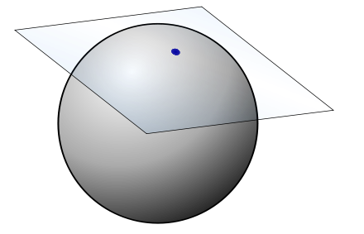
Lie Groups, G
Group a set and an operation operation: associative, identity, inverse
(R, ·)
Manifold: paracompact, Hausdorff, and locally Euclidean
Smooth manifold: charts, with transition functions infinitely differentiable
Notes:
a set and an operation that combines any two elements of the set to produce a third element of the set, in such a way that the operation is associative, an identity element exists and every element has an inverse

Slide 9
Lie Algebra, g
The Lie algebra g of a N dimensional Lie group is its tangent space at the identity, which is a vector space of N dimensions.
e
Notes:
Lie Algebra, g: The Lie algebra g of a N dimensional Lie group is its tangent space at the identity, which is a vector space of N dimensions. We can see the algebra elements as infinitesimal generators, from which all other elements in the group can be created. For matrix Lie groups we can represent vectors v in the tangent space as matrices v×.

Slide 10
Exponential Map
Map: An element of the algebra → Vector field on the group manifold
Exp: g → G, maps from algebra element to group element
Log: inverse of Exp, often multi-valued.
e
a
Notes:
Exponential Map, exp(·): The structure of the algebra creates a map from an element of the algebra to a vector field on the group manifold. This gives rise to the exponential map, exp : g → G which maps an algebra element to the group element at unit length from the identity along the flow of the vector field. The zero vector is thus mapped to the identity. For compact connected Lie groups, such as SO(3), the exponential map is surjective. Often, the map is not injective, so the inverse, the log map, is multi-valued.
The exponential map of matrix Lie groups is the matrix exponential.

Slide 11
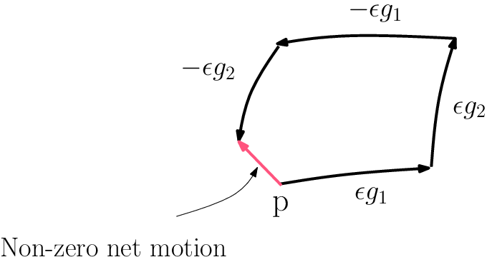
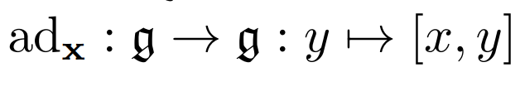
Adjoint Representations
Bracket [-, -]: g x g → g
Bracket of matrix lie group is the commutator of the algebra matrices.
Adjoint representation of x is the matrix representation of the linear map
Notes:
Lie algebra equipped with a bracket, which is bilieanr

Slide 12
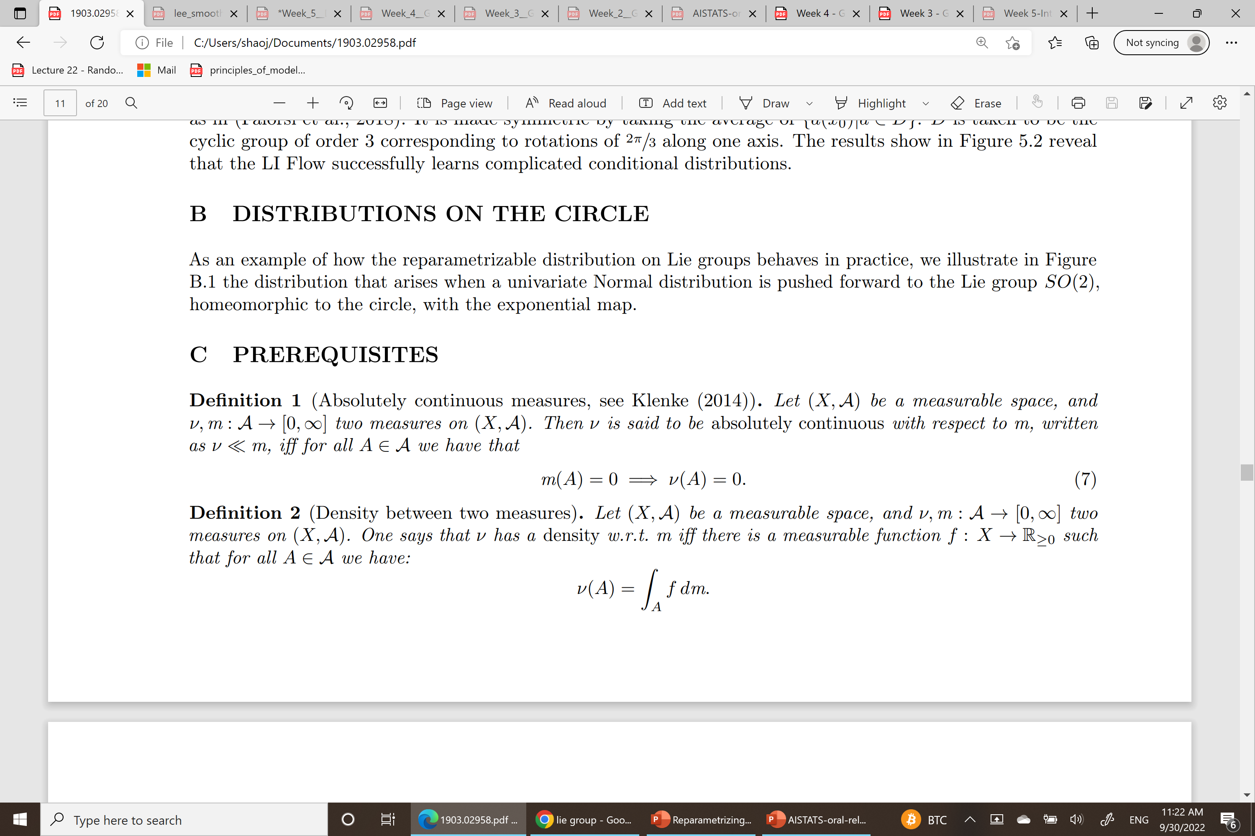
Measures
(X, A) be a measurable space
ν, m : A → [0, ∞] two measures on (X, A).
Absolutely Continuous Measures: v << m iff
Density between two measures
Notes:
Definition 1 (Absolutely continuous measures, see Klenke (2014)). Let (X, A) be a measurable space, and ν, m : A → [0, ∞] two measures on (X, A). Then ν is said to be absolutely continuous with respect to m, written as ν m, iff for all A ∈ A we have that m(A) = 0 =⇒ ν(A) = 0. (7)
Definition 2 (Density between two measures). Let (X, A) be a measurable space, and ν, m : A → [0, ∞] two measures on (X, A). One says that ν has a density w.r.t. m iff there is a measurable function f : X → R≥0 such that for all A ∈ A we have:

Slide 13
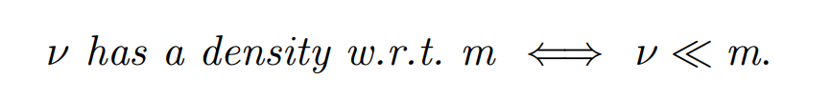
Radon-Nikodym
Notes:
(Radon-Nikodým, see Klenke (2014) Cor. 7.34). Let (X, A) be a measurable space, and ν, m : A → [0, ∞] two σ-finite measures on (X, A). Then one has the equivalence:

Slide 14
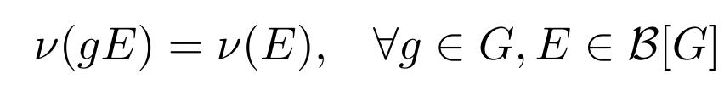
Haar Measure
Riemannian metric g
Left invariant metric induces a left invariant measure
Notes:
A standard choice for Lie groups is to use a left invariant metric, which automatically induces a left invariant measure ν, called the Haar measure (unique up to a constant):
where gE is the set obtained by applying the group element to each element in the set E.
More intuitively, this implies that left multiplication doesn’t change volume.

Slide 15
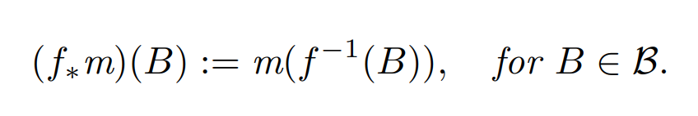
Pushforward Measure
f: X→ Y measurable map
f
(X, A)
(Y, B)
m
Pushforward measure
R

Slide 16
Pushforward Measure
Exp
(g, A)
(G, B)
m
Exp*m
R
need Exp*m << v
If Exp is injective, the pushforward measure has density on v
Notes:
Applying the exponential map, we define a new measure on G9 , technically called the pushforward measure, exp∗ (m) 10. However, G already comes equipped with another measure ν, not necessarily equal to exp∗ (m). Hence, if we consider a prior distribution that has a density on ν, in order to compute quantities such as the Kullback-Leibler divergence we also need exp∗ (m) ν, meaning it has a density qˆ w.r.t. ν
In the case the exponential map is injective, it can easily be shown that the pushforward measure has a density on ν 11. However, that these requirements are not necessarily fulfilled can be best explained through a simple example:

Slide 17
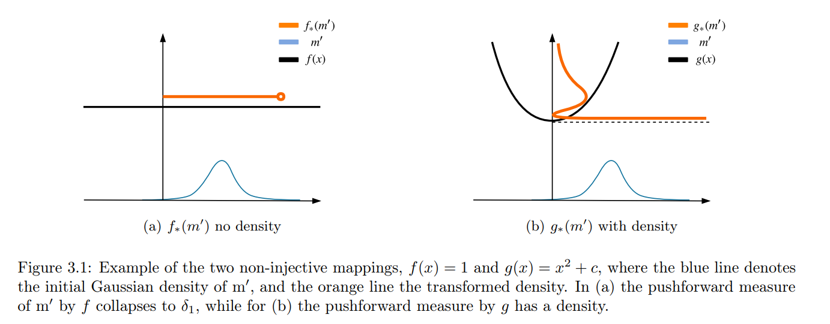
What if the exponential map is not injective?
Notes:
Consider f : R → R, s.t. f(x) = 1, ∀x ∈ R, this function is clearly differentiable (see Fig. 1(a)). If we take a measure m0 , with a Gaussian density, the pushforward of m0 by f is a Dirac delta, δ1, for which it no longer holds that f∗(m0 ) λ. Intuitively, this happens because f is not injective since all points x ∈ R are mapped to 1, such that all the mass of the pushforward measure is concentrated on a single point.
Yet, this does not mean that all non-injective mappings can not be used. Instead, consider g : R → R, s.t. g(x) = x 2 + c, ∀x ∈ R with c ∈ R a constant, and m0 as before (see Fig. 1(b)). Although g is clearly not injective, for the pushforward measure by g we still have g∗(m0 ) λ.
The key property here, is that it’s possible to partition the domain of g into the sets (−∞, 0) ∪ (0, ∞) ∪ {0}. For the first two, we can now apply the change of variable method on each, as g is injective when restricted to either. The zero set can be ignored, since it has Lebesgue measure 0.
Parition idea can be generally extended for Lie groups, by proving that the Lie algebra domain can be partitioned in a set of measure zero and a countable union of open sets in which the exponential map is a diffeomorphism.

Slide 18
What if the exponential map is not injective?
Key property: you can partition g into the sets (−∞, 0) ∪ (0, ∞) ∪ {0}
Lie group: Lie algebra domain can be partitioned
Notes:
Consider f : R → R, s.t. f(x) = 1, ∀x ∈ R, this function is clearly differentiable (see Fig. 1(a)). If we take a measure m0 , with a Gaussian density, the pushforward of m0 by f is a Dirac delta, δ1, for which it no longer holds that f∗(m0 ) λ. Intuitively, this happens because f is not injective since all points x ∈ R are mapped to 1, such that all the mass of the pushforward measure is concentrated on a single point.
Yet, this does not mean that all non-injective mappings can not be used. Instead, consider g : R → R, s.t. g(x) = x 2 + c, ∀x ∈ R with c ∈ R a constant, and m0 as before (see Fig. 1(b)). Although g is clearly not injective, for the pushforward measure by g we still have g∗(m0 ) λ.
The key property here, is that it’s possible to partition the domain of g into the sets (−∞, 0) ∪ (0, ∞) ∪ {0}. For the first two, we can now apply the change of variable method on each, as g is injective when restricted to either. The zero set can be ignored, since it has Lebesgue measure 0.
Parition idea can be generally extended for Lie groups, by proving that the Lie algebra domain can be partitioned in a set of measure zero and a countable union of open sets in which the exponential map is a diffeomorphism.
Now we can actually compute the density of the pushforward measure!

Slide 19
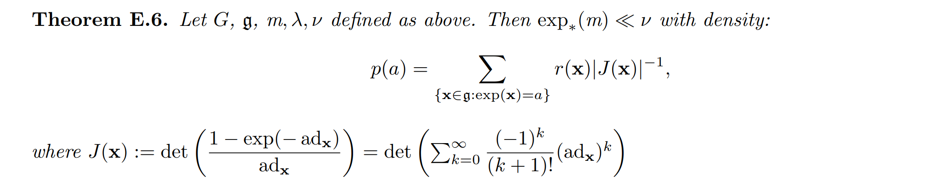
Main Theorem
Contributions from all pre-image algebra elements
Notes:
The change of volume is the determinant of the Jacobian. To compute it, we express the tangent space at the output in terms of the chosen basis of the Lie algebra. This is possible, since a basis for a Lie algebra provides a unique basis for the tangent space throughout G. This can be computed analytically for any x, since the exp map of matrix Lie groups is the matrix exponential, for which derivatives are computable.
Nevertheless a general expression of J(x) exists for any Lie Group and is given in terms of the complex eigenvalue spectrum Sp(·) of the adjoint representation of x, which is a linear map:

Slide 20
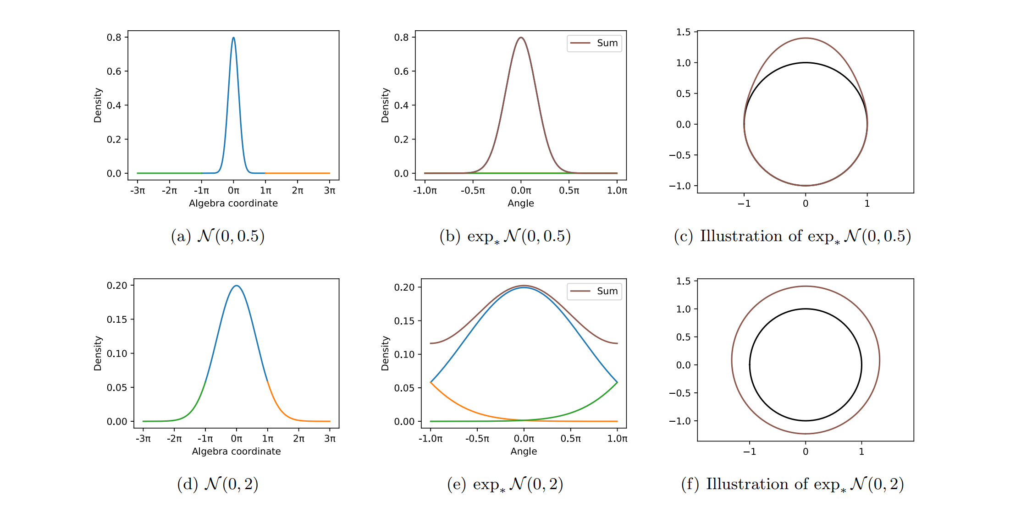
Pushforward to SO(2), Lie Algebra R
Notes:
Density of pushforward of Normal distributions with zero mean and scale 0.5 and 2 to the Lie group SO(2). Following Equation 3, the density on the group in (b) and (e) at angle θ is simply the sum of the algebra density of the pre-images of θ. The circular representation in (c) and (f) illustrate the density q on the group by drawing a loop with radius 1 + q(θ), for angle θ.

Slide 21
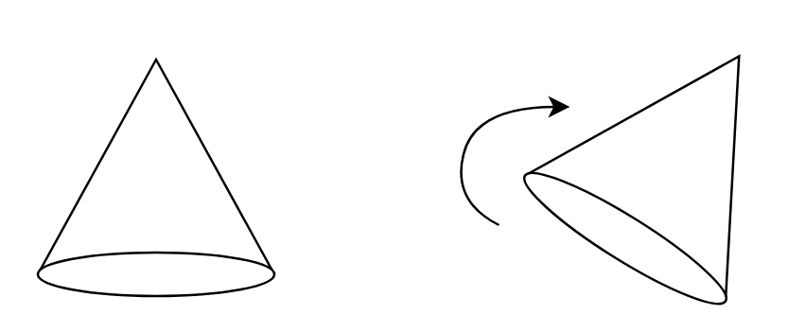
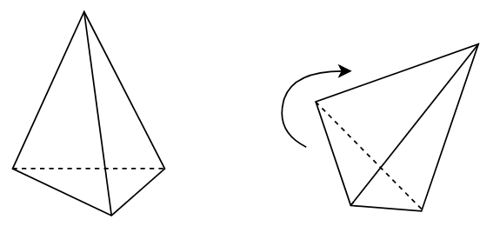
The Special Orthogonal Group SO(3)
Group of 3D oriented rotations, describe rotations of static object
Notes:
3 x 3 matrices
What is the lie algebra?

Slide 22
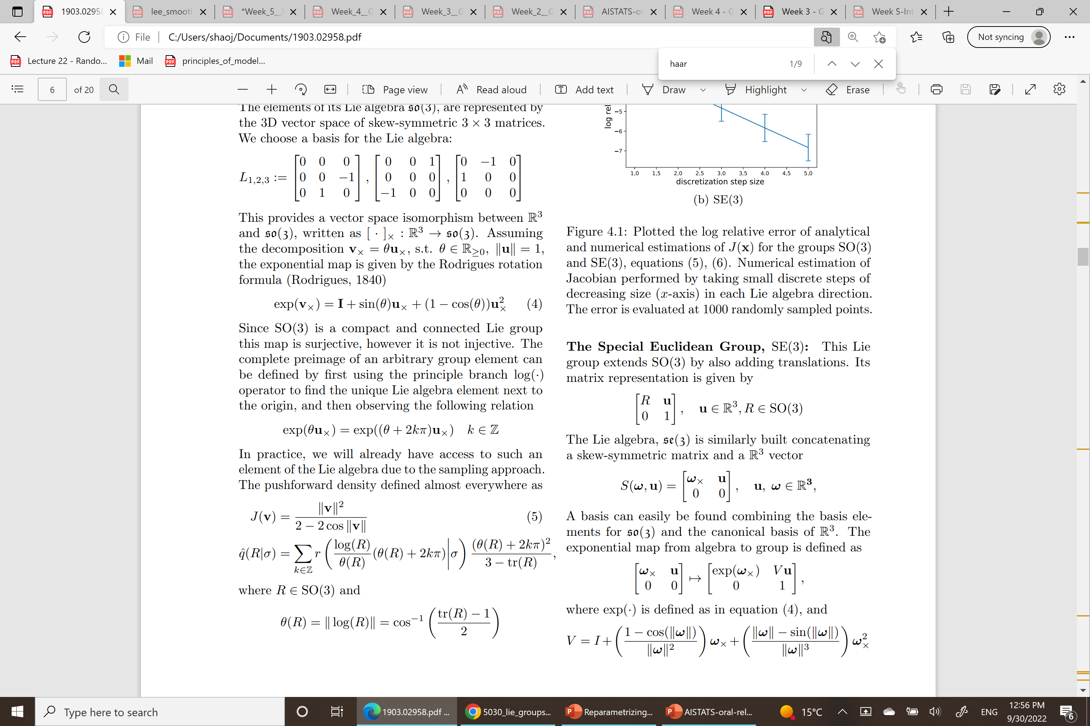

The Special Orthogonal Group SO(3)
Basis for Lie algebra
Exponential map

Slide 23
The Special Orthogonal Group SO(3)
Basis for Lie algebra
Exponential map

Slide 24

The Special Orthogonal Group SO(3)

Slide 25
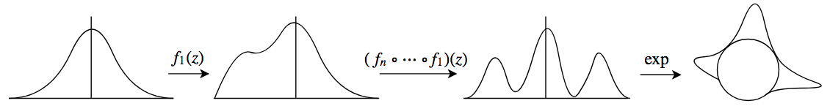
Experiments: Normalizing Flow
True posterior: circular subgroup / discrete subgroup (order 3)
Multi-modal distributions needed:
Recall we can use arbitrary base distribution in the Lie Algebra
Why not use Normalizing Flows (NF)?
Basic NF: use repeated invertible transformations to create complex density
Parameterize very complex distribution in Lie Algebra and push to Lie Group

Slide 26
Experiment: Variational Inference
Task: given two views of an object, find which rotation(s) relate(s) them
Variational Inference on SO(3)-valued latent
Object (a) has rotational symmetry around one axis
Object (b) has threefold discrete symmetry around one axis
Notes:
In this experiment we estimate the SO(3) group actions that leave a symmetrical object invariant. This highlights how our method can be used in probabilistic generative models and unsupervised learning tasks. We have a generative model p(x|g) and a uniform prior over the latent variable g. Using Variational Inference we optimize the Evidence Lower Bound to infer an approximate posterior q(g|x) modeled with LI-Flow.
Results are shown in Fig. 5.1 and compared to Markov Chain Monte Carlo samples. We observe the symmetries are correctly inferred

Slide 27
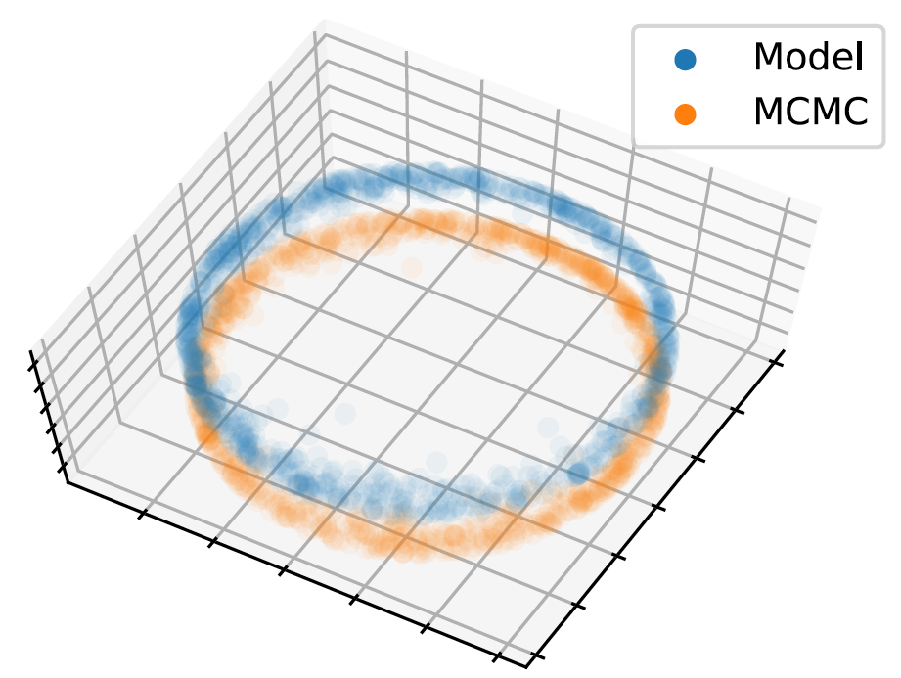
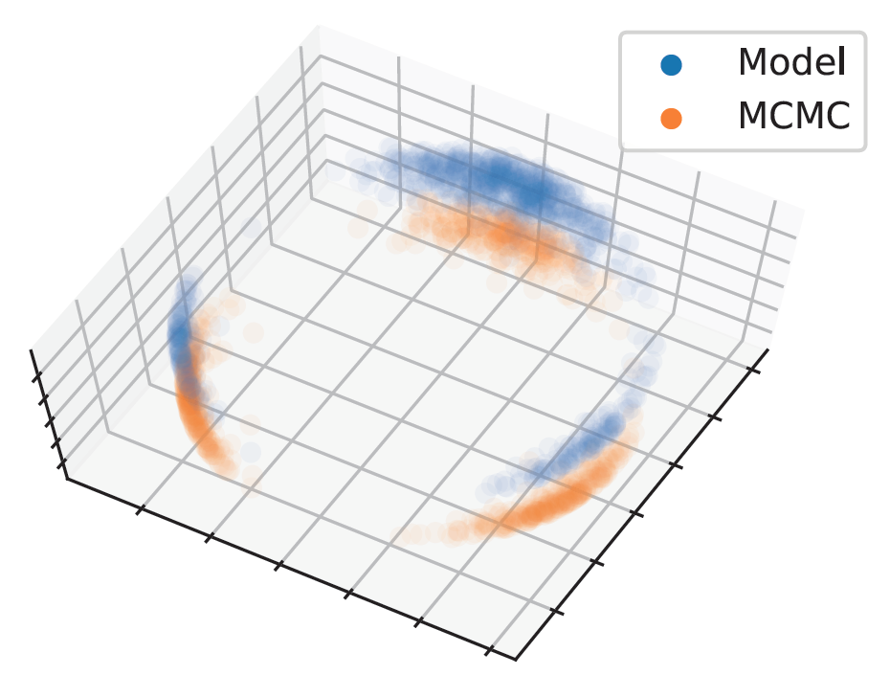
Experiment: Variational Inference
Notes:
In this experiment we estimate the SO(3) group actions that leave a symmetrical object invariant. This highlights how our method can be used in probabilistic generative models and unsupervised learning tasks. We have a generative model p(x|g) and a uniform prior over the latent variable g. Using Variational Inference we optimize the Evidence Lower Bound to infer an approximate posterior q(g|x) modeled with LI-Flow.
Results are shown in Fig. 5.1 and compared to Markov Chain Monte Carlo samples. We observe the symmetries are correctly inferred

Slide 28
Experiment: MLE
Have noisy observations of an object x from different poses
Need to estimate pose p(g|x)
x0 random vector
g’ = exp(ε)g
x’ = g’(x0)
Estimate p(g’|x)
Notes:
Setup We generate a random vector x0 that has a linear Lie group action. Then we create a random variable g ∈ G uniformly distributed representing the pose and a noisy version g 0 = exp()g with ∼ (0, 0.01). We observe x 0 = g 0 (x0) and need to predict g. This corresponds to having noisy observations of an object x from different poses and needing to estimate the pose p(g|x 0 ). When the object is symmetrical, that is a subgroup D ⊂ G exists such that d(x0) = x0 for all d ∈ D, p(g|x 0 ) should have modes corresponding to the values in D.
Results This is evaluated on SO(3). The object x0 is taken to an element of the representation space of SO(3), as in (Falorsi et al., 2018). It is made symmetric by taking the average of {d(x0)|d ∈ D}. D is taken to be the cyclic group of order 3 corresponding to rotations of 2π/3 along one axis. The results show in Figure 5.2 reveal that the LI Flow successfully learns complicated conditional distributions.

Slide 29
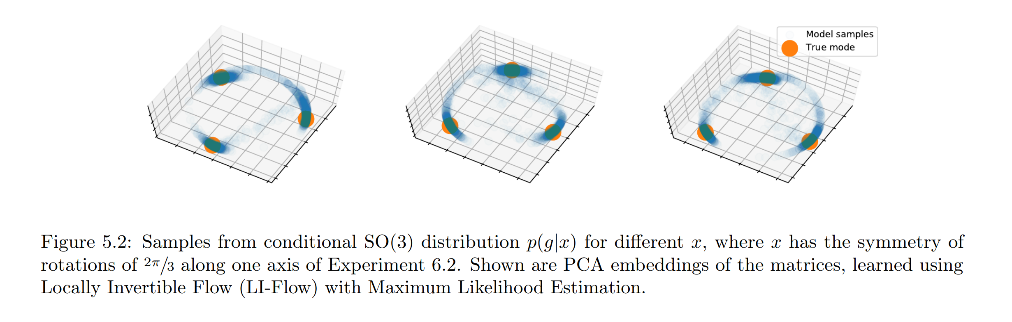
Experiment: MLE
Notes:
Setup We generate a random vector x0 that has a linear Lie group action. Then we create a random variable g ∈ G uniformly distributed representing the pose and a noisy version g 0 = exp()g with ∼ (0, 0.01). We observe x 0 = g 0 (x0) and need to predict g. This corresponds to having noisy observations of an object x from different poses and needing to estimate the pose p(g|x 0 ). When the object is symmetrical, that is a subgroup D ⊂ G exists such that d(x0) = x0 for all d ∈ D, p(g|x 0 ) should have modes corresponding to the values in D.
Results This is evaluated on SO(3). The object x0 is taken to an element of the representation space of SO(3), as in (Falorsi et al., 2018). It is made symmetric by taking the average of {d(x0)|d ∈ D}. D is taken to be the cyclic group of order 3 corresponding to rotations of 2π/3 along one axis. The results show in Figure 5.2 reveal that the LI Flow successfully learns complicated conditional distributions.

Slide 30
Conclusions
Push density from Lie Algebra (Rn) to Lie Groups
Create multimodal distributions through Normalizing Flow
Use in VI and MLE on problems of discrete and continuous symmetries
Future
Experiments in rigid body motion, optimal control

Slide 31
References

